Slide 1
MALIGNANT COMMENTS CLASSIFIER PROJECT
SUBMITTED BY,
FEMINA ANEESH

Slide 2
INTRODUCTION
The proliferation of social media enables people to express their opinions widely online. However, at the same time, this has resulted in the emergence of conflict and hate, making online environments uninviting for users. Although researchers have found that hate is a problem across multiple platforms, there is a lack of models for online hate detection.
Online hate, described as abusive language, aggression, cyberbullying, hatefulness and many others has been identified as a major threat on online social media platforms. Social media platforms are the most prominent grounds for such toxic behaviour.
There has been a remarkable increase in the cases of cyberbullying and trolls on various social media platforms. Many celebrities and influences are facing backlashes from people and have to come across hateful and offensive comments. This can take a toll on anyone and affect them mentally leading to depression, mental illness, self-hatred and suicidal thoughts.
Internet comments are bastions of hatred and vitriol. While online anonymity has provided a new outlet for aggression and hate speech, machine learning can be used to fight it. The problem we sought to solve was the tagging of internet comments that are aggressive towards other users. This means that insults to third parties such as celebrities will be tagged as unoffensive, but “u are an idiot” is clearly offensive.
Our goal is to build a prototype of online hate and abuse comment classifier which can used to classify hate and offensive comments so that it can be controlled and restricted from spreading hatred and cyberbullying.

Slide 3
Conceptual Background of the Domain Problem
In the past few years its seen that the cases related to social media hatred have increased exponentially. The social media is turning into a dark venomous pit for people now a days. Online hate is the result of difference in opinion, race, religion, occupation, nationality etc.
In social media the people spreading or involved in such kind of activities uses filthy languages, aggression, images etc. to offend and gravely hurt the person on the other side. This is one of the major concerns now.
The result of such activities can be dangerous. It gives mental trauma to the victims making their lives miserable. People who are not well aware of mental health online hate or cyber bullying become life threatening for them. Such cases are also at rise. It is also taking its toll on religions. Each and every day we can see an incident of fighting between people of different communities or religions due to offensive social media posts.
Online hate, described as abusive language, aggression, cyberbullying, hatefulness, insults, personal attacks, provocation, racism, sexism, threats, or toxicity has been identified as a major threat on online social media platforms. These kinds of activities must be checked for a better future.

Slide 4
Motivation for the Problem Undertaken
The project was the first provided to me by FlipRobo as a part of the internship programme. The exposure to real world data and the opportunity to deploy my skillset in solving a real time problem has been the primary objective. However, the motivation for taking this project was that it is relatively a new field of research. Here we have many options but less concrete solutions. The main motivation is to build a prototype of online hate and abuse comment classifier which can used to classify hate and offensive comments so that it can be controlled and restricted from spreading hatred and cyberbullying.
rt of the internship programme. The exposure to real world data and the opportunity to deploy my skillset in solving a real time problem has been the primary objective. However, the motivation for taking this project was that it is relatively a new field of research. Here we have many options but less concrete solutions. The main motivation is to build a prototype of online hate and abuse comment classifier which can used to classify hate and offensive comments so that it can be controlled and restricted from spreading hatred and cyberbullying

Slide 5
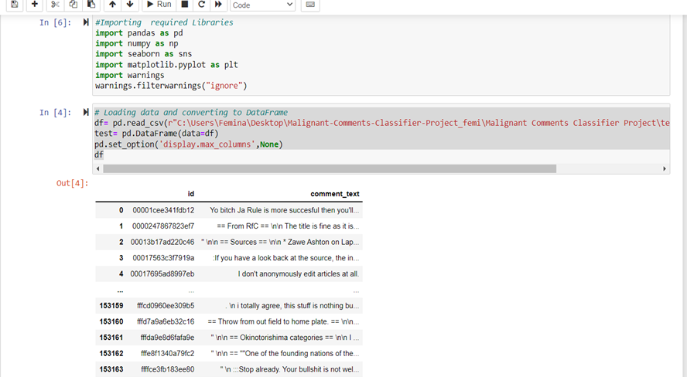
Loading Necessary libraries and Train and test dataset

Slide 6
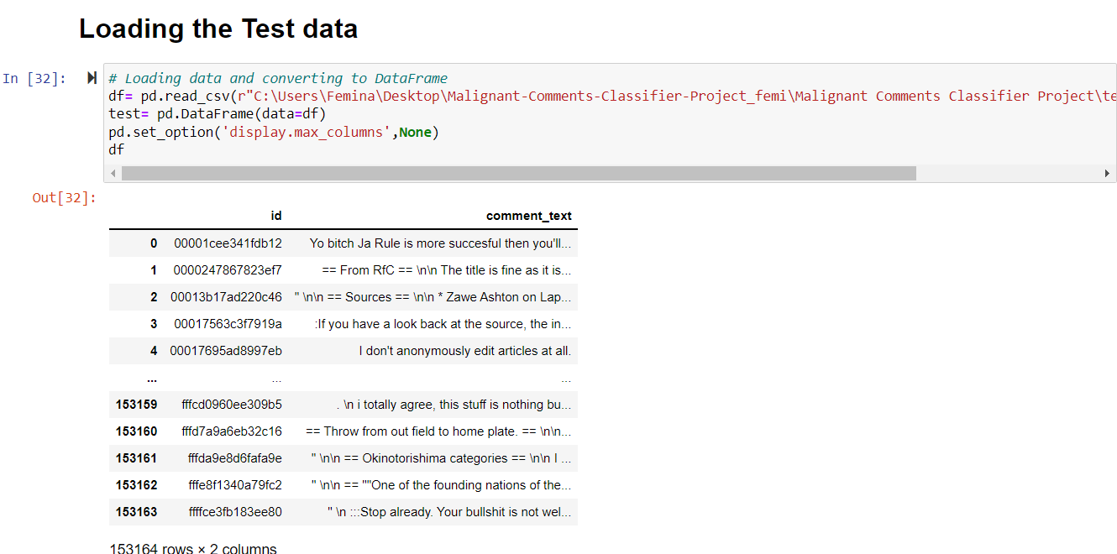

Slide 7
MULTI-LABEL VS MULTI CLASS CLASSIFICATION
In multi-class classification, the data can belong to only one label out of all the labels we have. For example, a given picture of an animal may be a cat, dog or elephant only and not a combination of these.
In multi-label classification, data can belong to more than one label simultaneously. For example, in our case a comment may be malignant, threat or loathe at the same time. It may also happen that the comment is positive/neutral and hence does not belong to any of the six labels.
The goal of the multi-label classification is to determine whether or not a comment is toxic or non-toxic. If toxic, to determine what kind of toxicity the comment is, like-in, malignant, highly-malignant, threat, rude, abuse or loathe. Thus, a model needs to be created in order to differentiate between comments and its categories.

Slide 8
DATA SOURCES AND THEIR FORMATS
The data set contains the training set, which has approximately 1,59,000 samples and the test set which contains nearly 1,53,000 samples. All the data samples contain 8 fields which includes ‘Id’, ‘Comments’, ‘Malignant’, ‘Highly malignant’, ‘Rude’, ‘Threat’, ‘Abuse’ and ‘Loathe’.
The label can be either 0 or 1, where 0 denotes a NO while 1 denotes a YES. There are various comments which have multiple labels. The first attribute is a unique ID associated with each comment.
The data set includes:
- Malignant: It is the Label column, which includes values 0 and 1, denoting if the comment is malignant or not.
- Highly Malignant: It denotes comments that are highly malignant and hurtful.
- Rude: It denotes comments that are very rude and offensive.
- Threat: It contains indication of the comments that are giving any threat to someone.
- Abuse: It is for comments that are abusive in nature.
- Loathe: It describes the comments which are hateful and loathing in nature.
- ID: It includes unique Ids associated with each comment text given.
- Comment text: This column contains the comments extracted from various social media platforms.

Slide 9
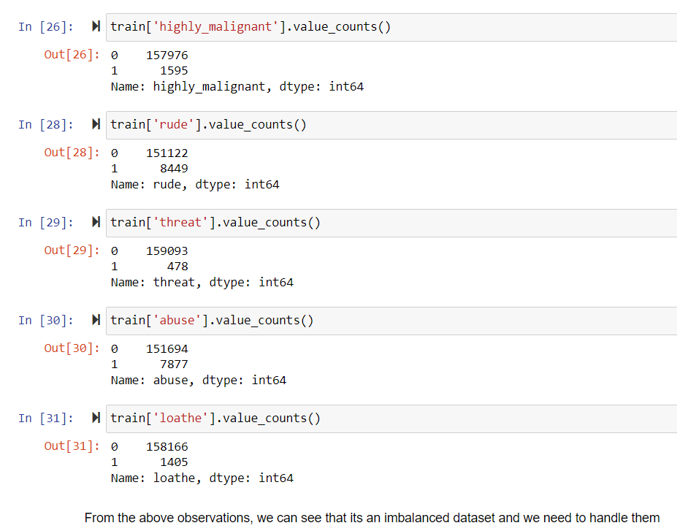
DATA PRE-PROCESSING
Checking the value counts of the features

Slide 10
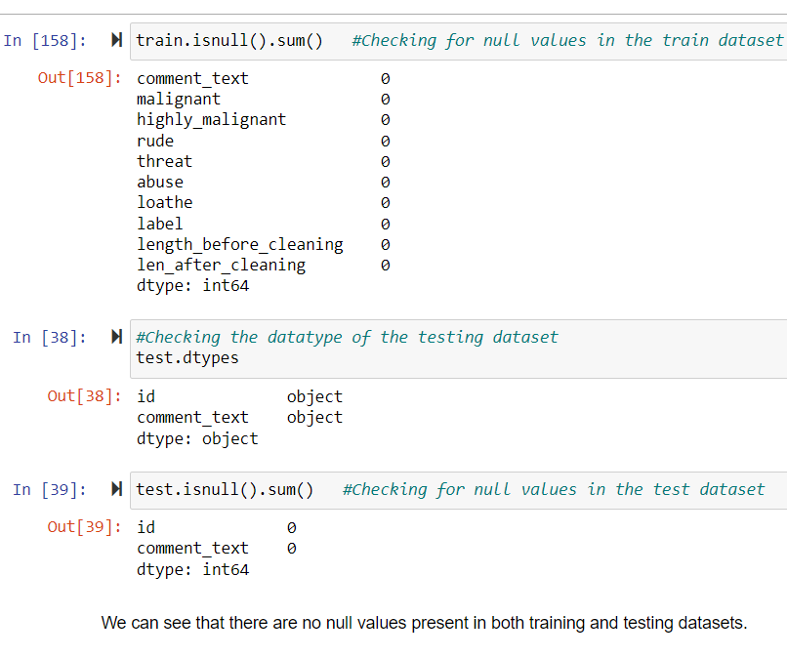
Checking for null values

Slide 11
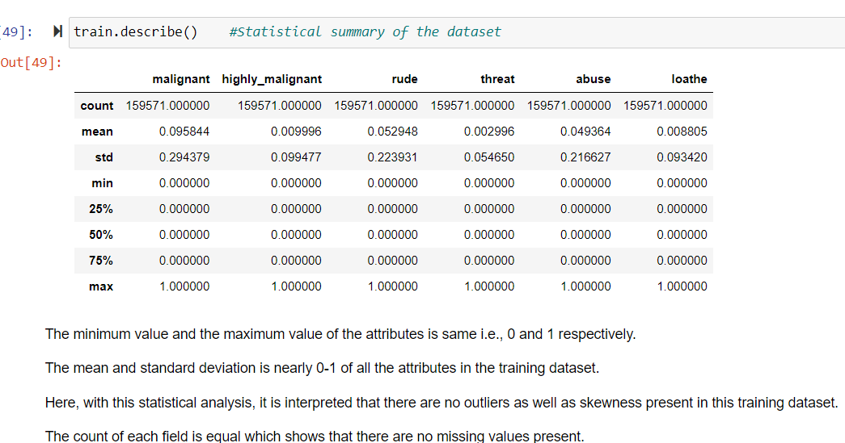
Checking statistical summary of the dataset

Slide 12
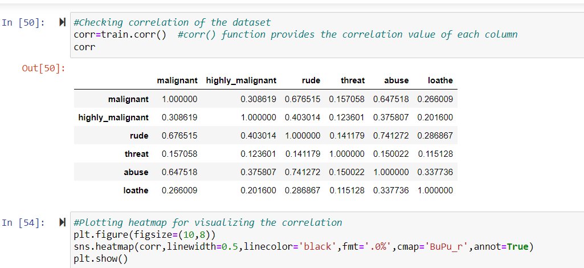
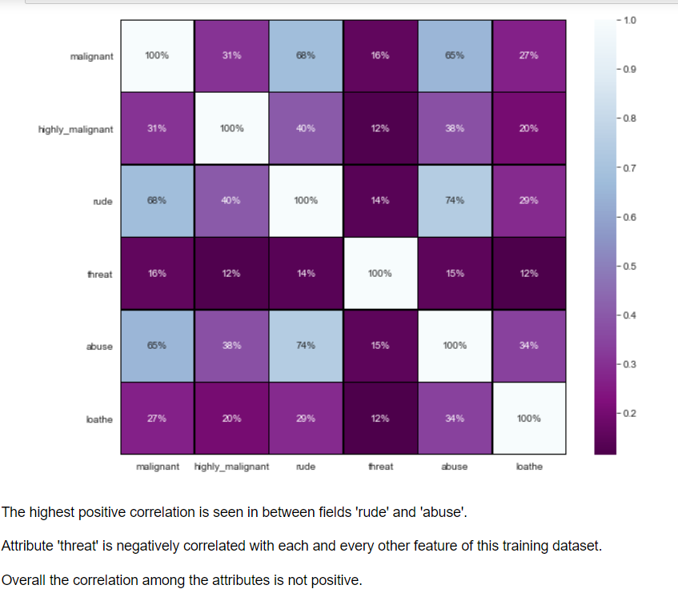
Finding relationship among data using correlation

Slide 13
Dropping the Column Due to the wide range of given data, it is extremely fruitful to clean, shape and set the data in the most suitable form. Dropping unnecessary columns declines the chances of producing errors. Thus, column ‘ID’ was dropped from the train dataset as every comment has its own unique id. After dropping the same, the dataset is now having 7 attributes in total including the target variables.
Cleaning the data using NLP
● Replaced the extra lines or ‘\n’ from the text.
● Transform the text into lower case.
● Replaced the email addresses with the text 'emailaddress'
● Replaced the URLs with the text 'webaddress'
● Removed the numbers
● Removed the HTML tags
● Removed the punctuations
● Removed all the non-ascii characters
● Removed the unwanted white spaces
● Removed the remaining tokens that are not alphabetic
● Removed the stop words

Slide 14
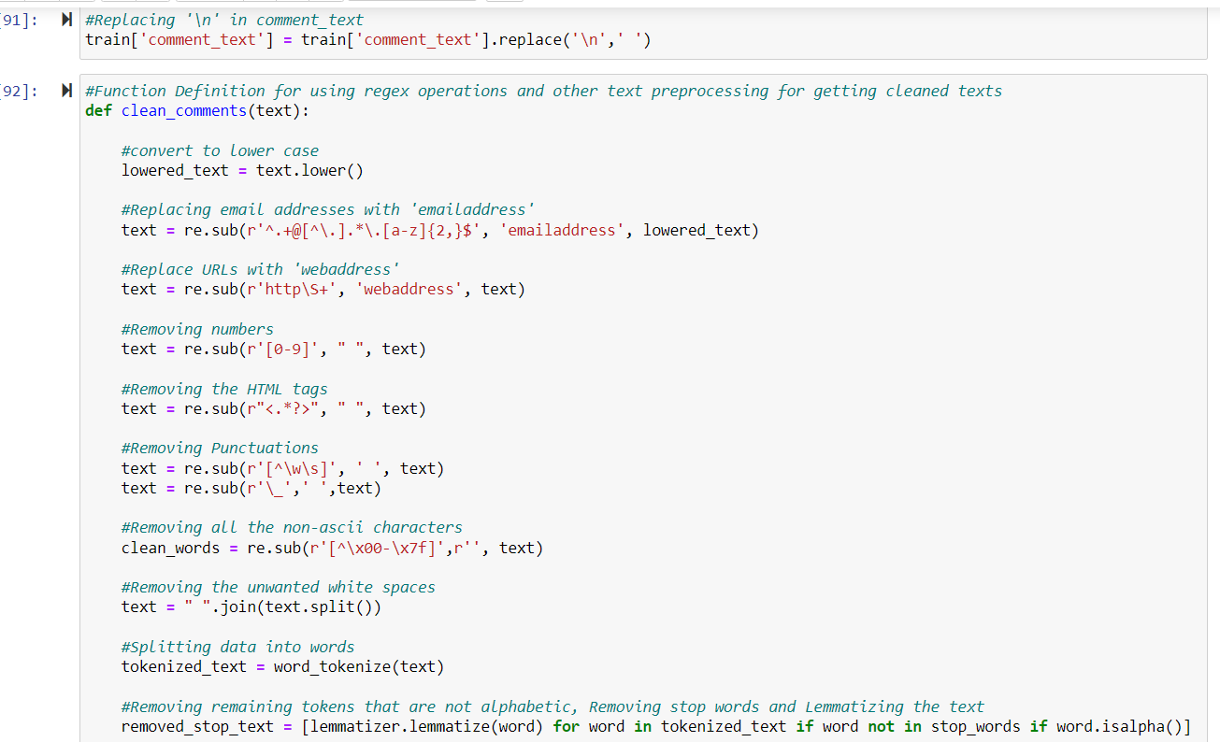

Slide 15
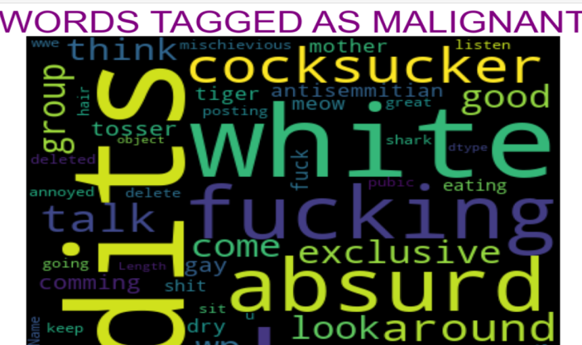
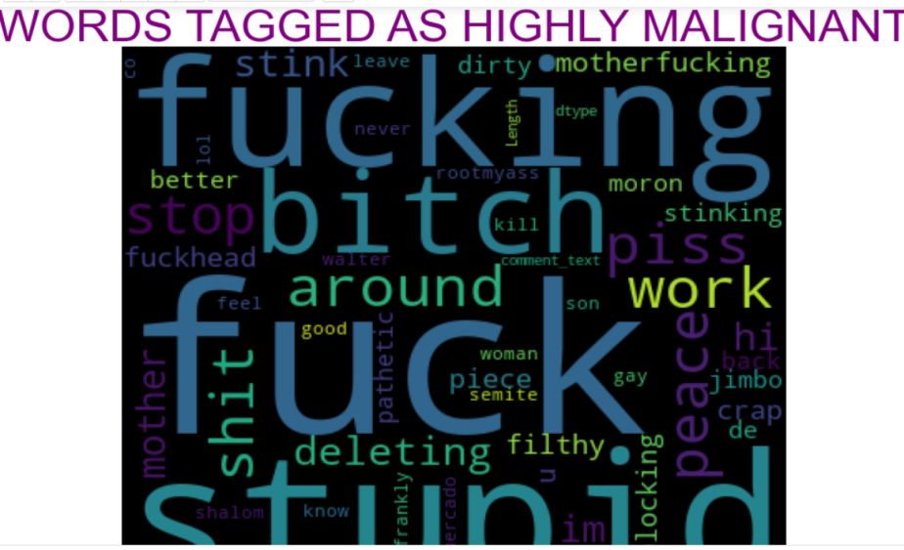
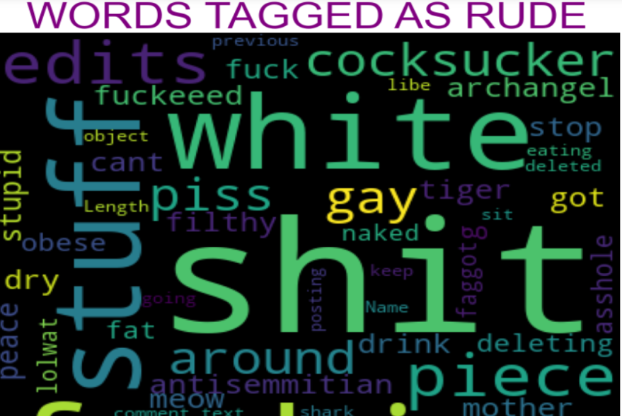
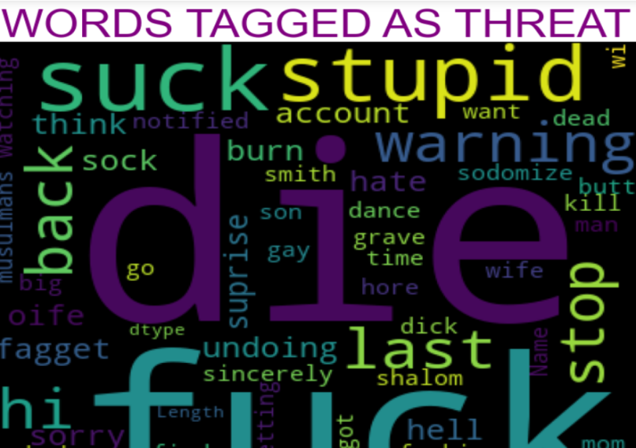
Plotting wordcloud for each feature

Slide 16
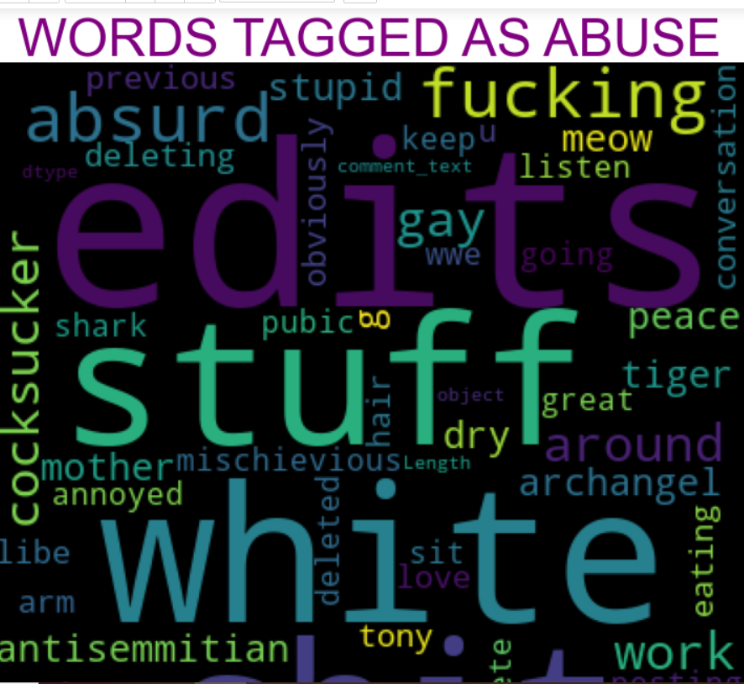
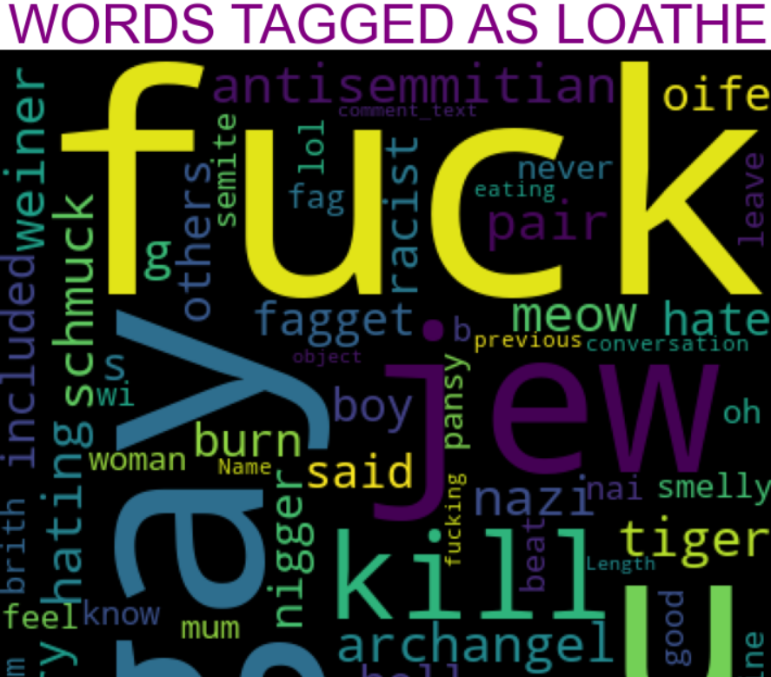

Slide 17
MODEL/S DEVELOPMENT AND EVALUATION
Separating independent and dependent features and converting the data into number features using Vectorizer

Slide 18
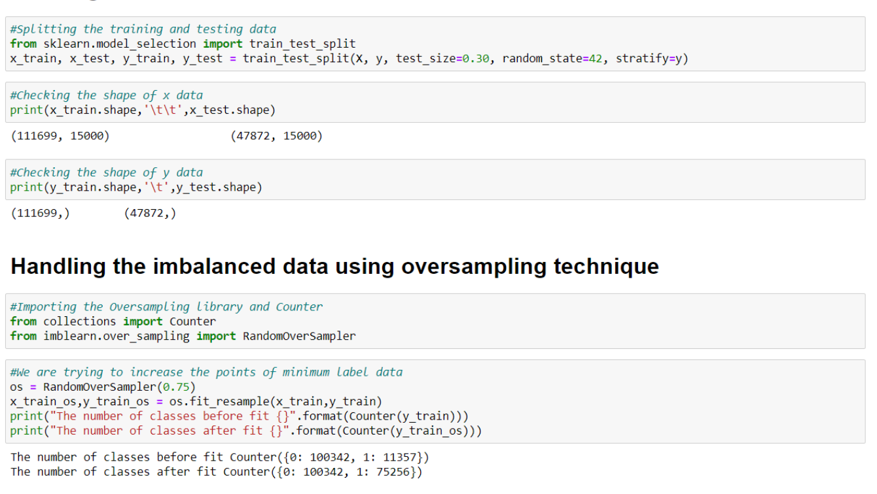
Splitting training and testing data, along with handling imbalanced dataset using RandomOverSampler

Slide 19
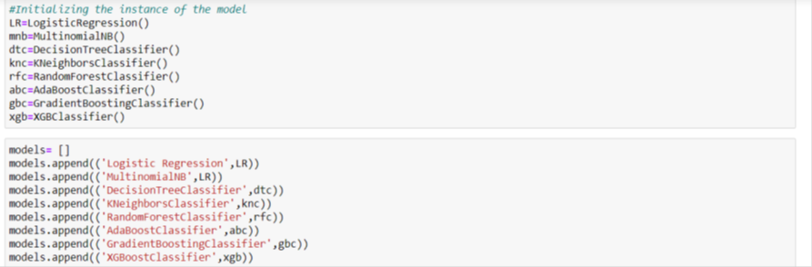
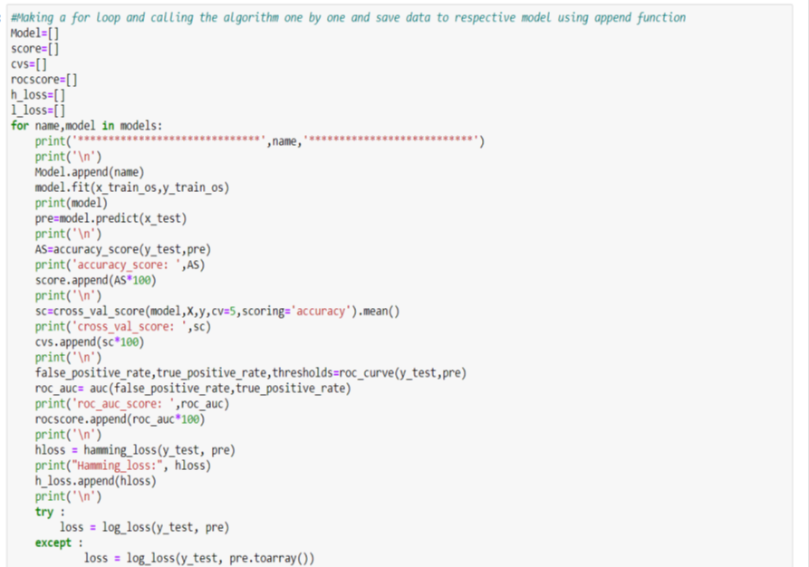
Building the model

Slide 20
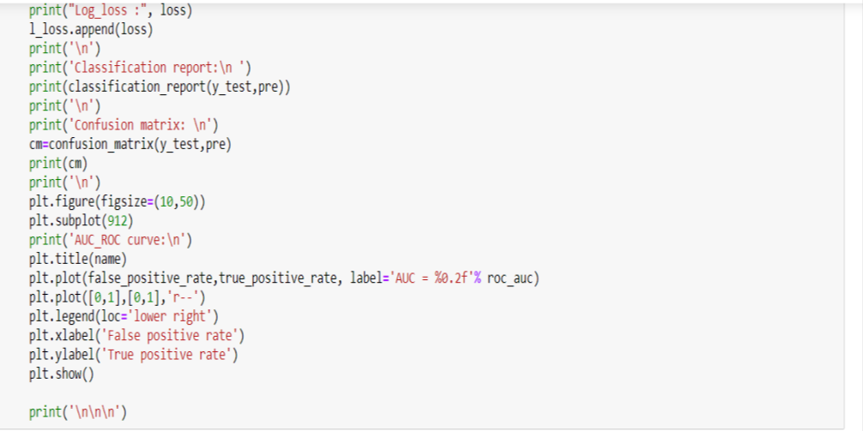
The best 2 models performed well were RandomForest and XGBoost Algorithms and their outputs are shown as follows:

Slide 21
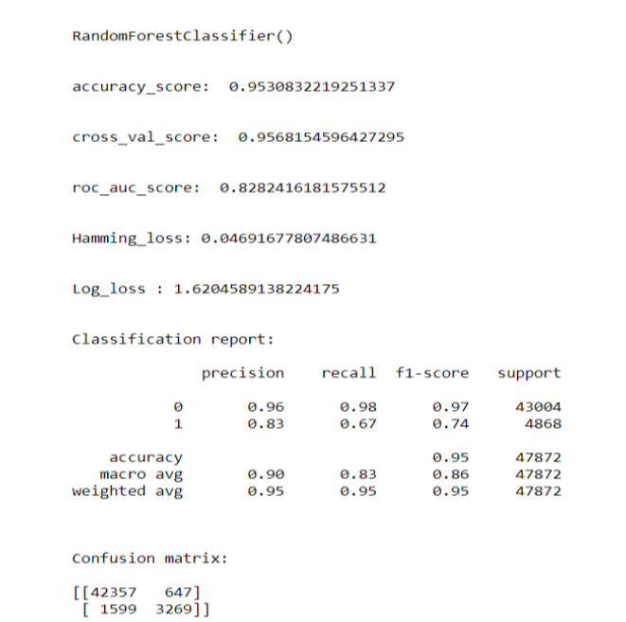
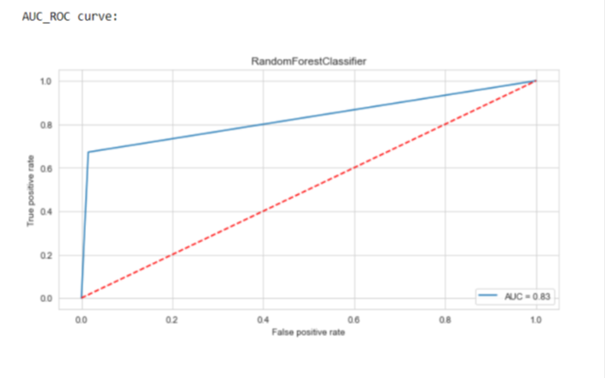

Slide 22
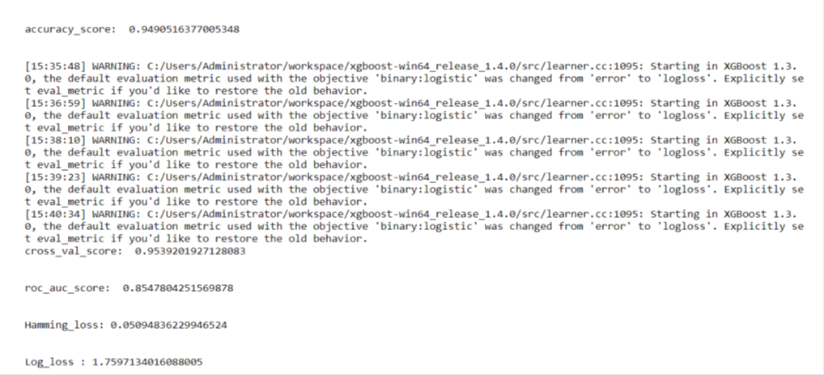
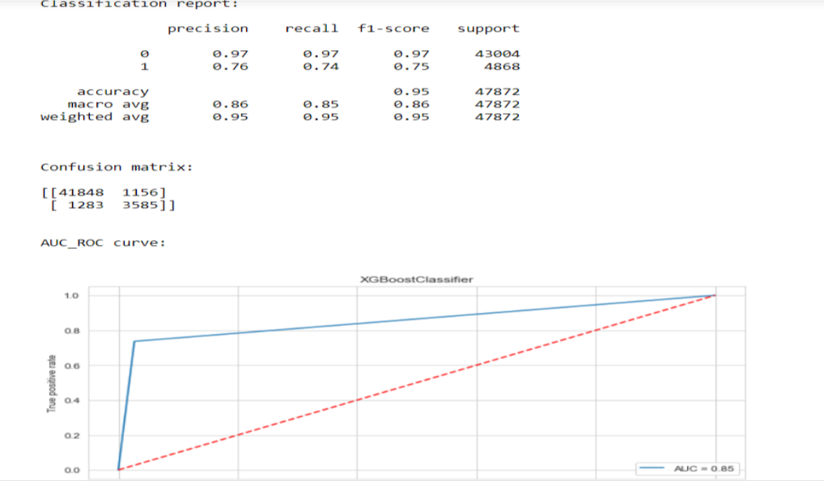

Slide 23
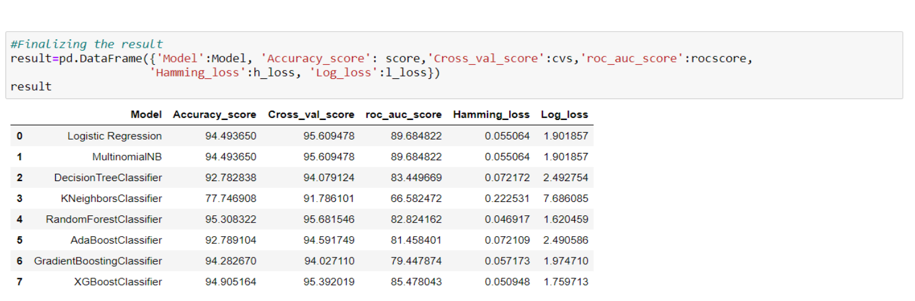
Final Result in a dataframe
After running the for loop of classification algorithms and the required metrics, we can see that the best 2 performing algorithms are RandomForestClassifier and XGBoostClassifier because the loss values are less and their scores are the best among all. Now, we will try Hyperparameter Tuning to find out the best parameters and using them to improve the scores and metrics values.

Slide 24
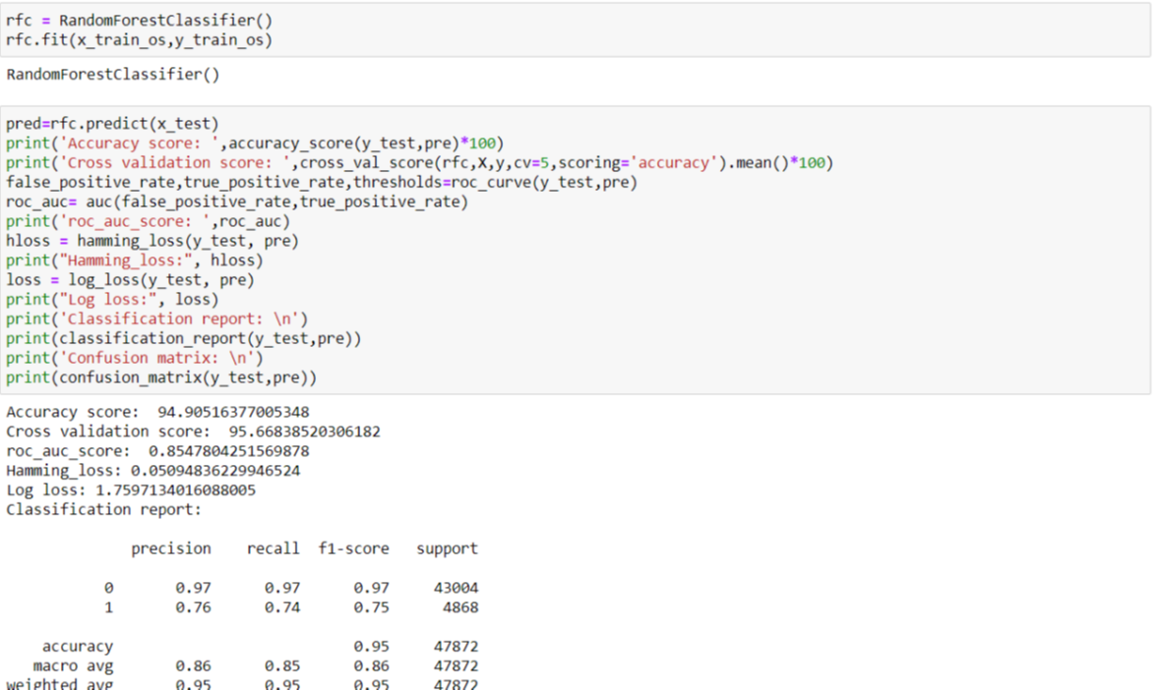
Hyperparameter Tuning
If we run GridSearchCV and RandomSearchCV, it takes more than 2 hours to run the code as the dataset is huge and the best params are not obtained from it due to more computational power requirement. The AUC Score, f1-score and recall value is high when we use randomforest with over sampling data. So, we choose RandomForestClassifier model with over sampled data as our best model among all models.
Confusion matrix:
[[41848 1156]
[ 1283 3585]]

Slide 25
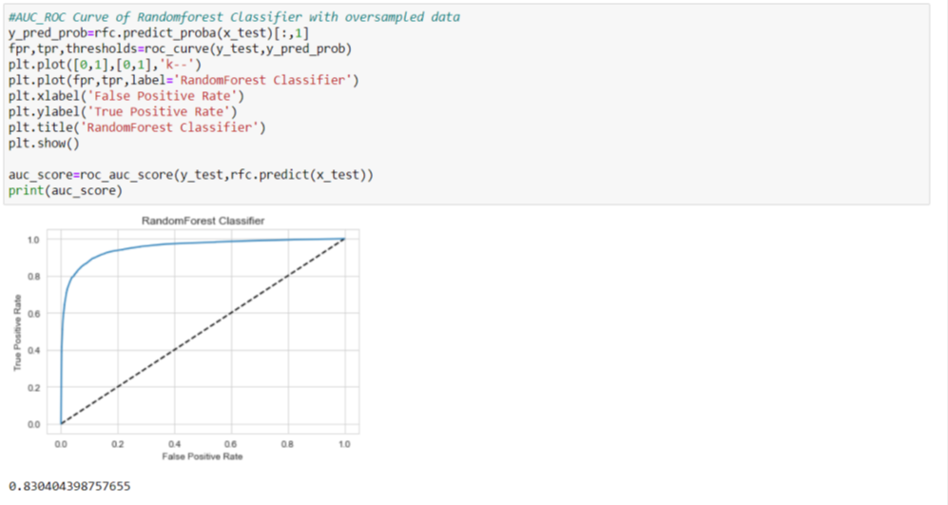
Plotting AUC_ROC Curve
Finalizing the model
We will final the model by predicting the values and saving the model in a pickle file, which will be used for prediction of test data

Slide 26
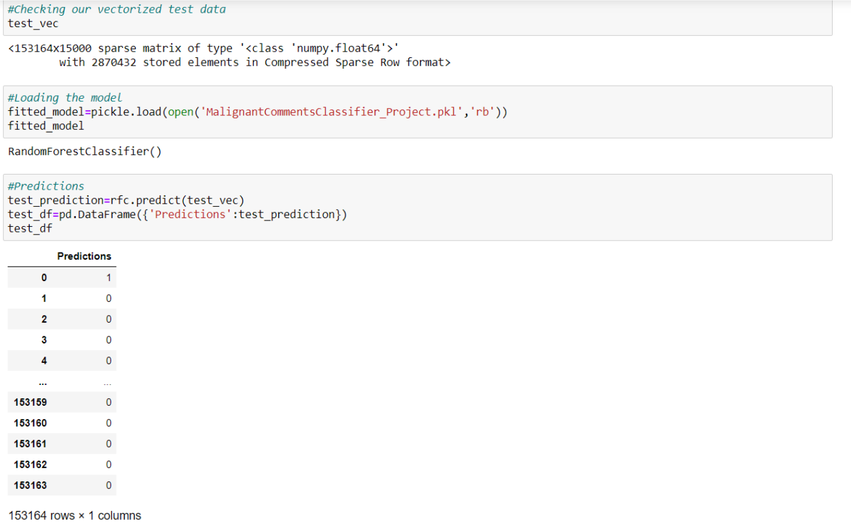
Predictions using test data
After predicting using test data, we will store the results in a csv file.

Slide 27
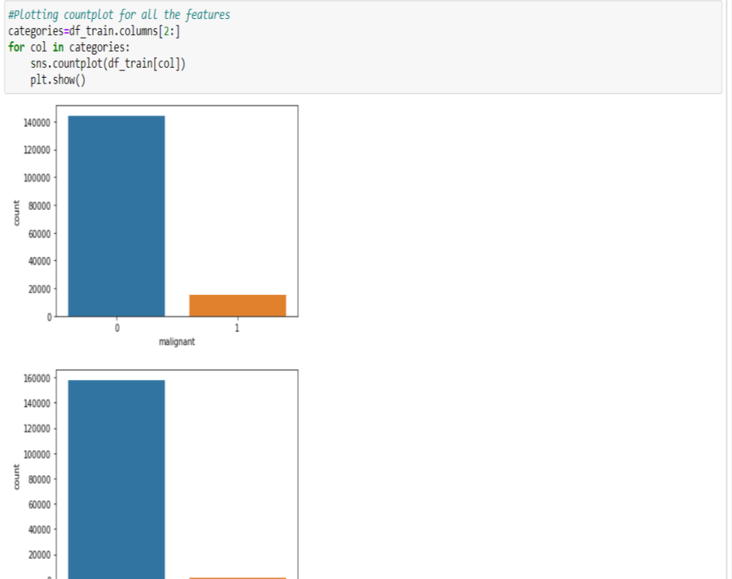
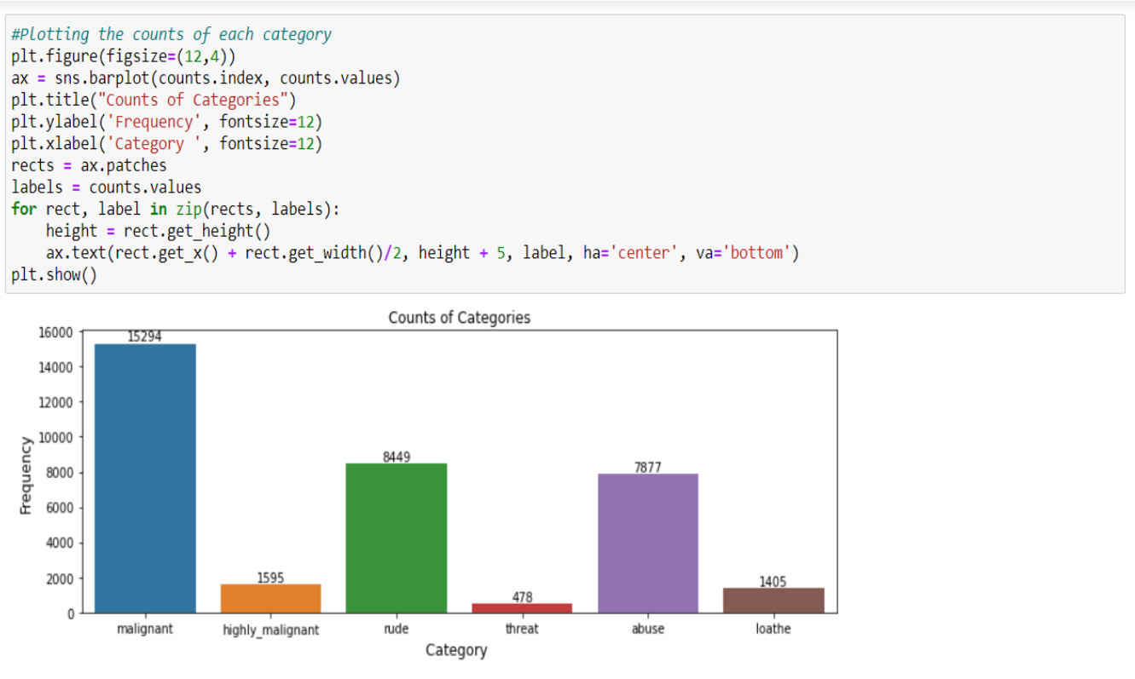
DATA VISUALIZATION
Plotting countplot for all features

Slide 28
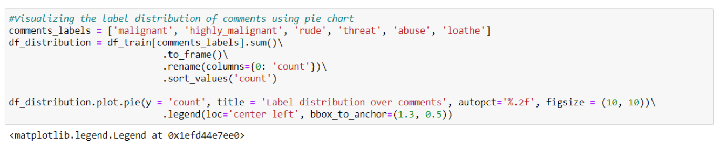
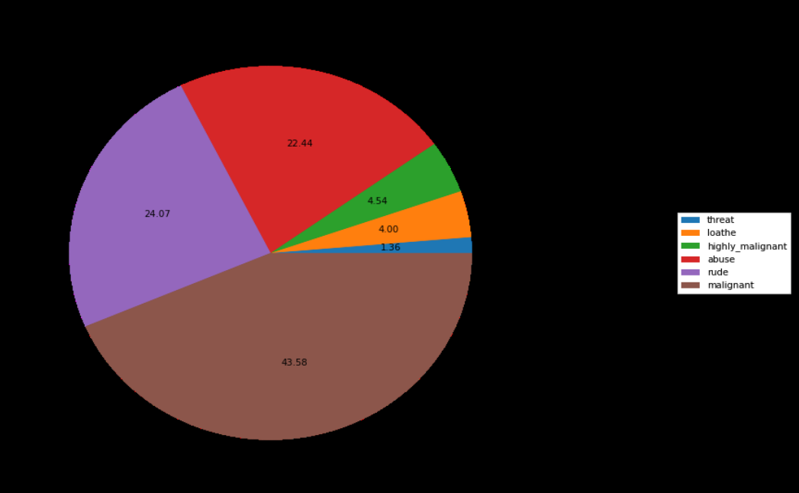
Plotting pie chart plot

Slide 29
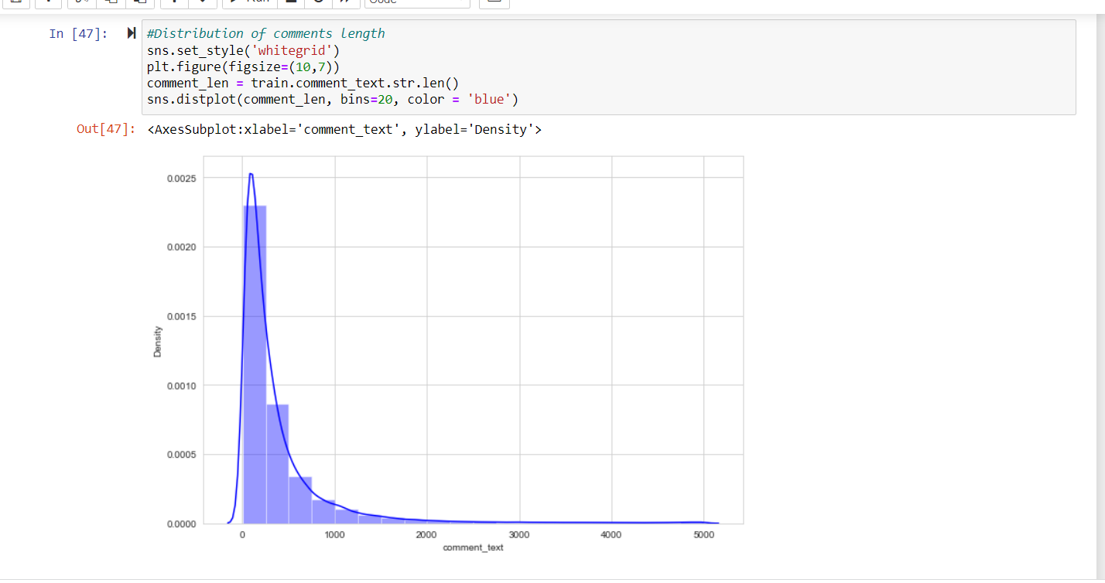
Distribution of comments length
Above is a plot showing the comment length frequency. As noticed, most of the comments are short with only a few comments longer than 1000 words. Majority of the comments are of length 500, where maximum length is 5000 and minimum length is 5. Median length being 250.

Slide 30
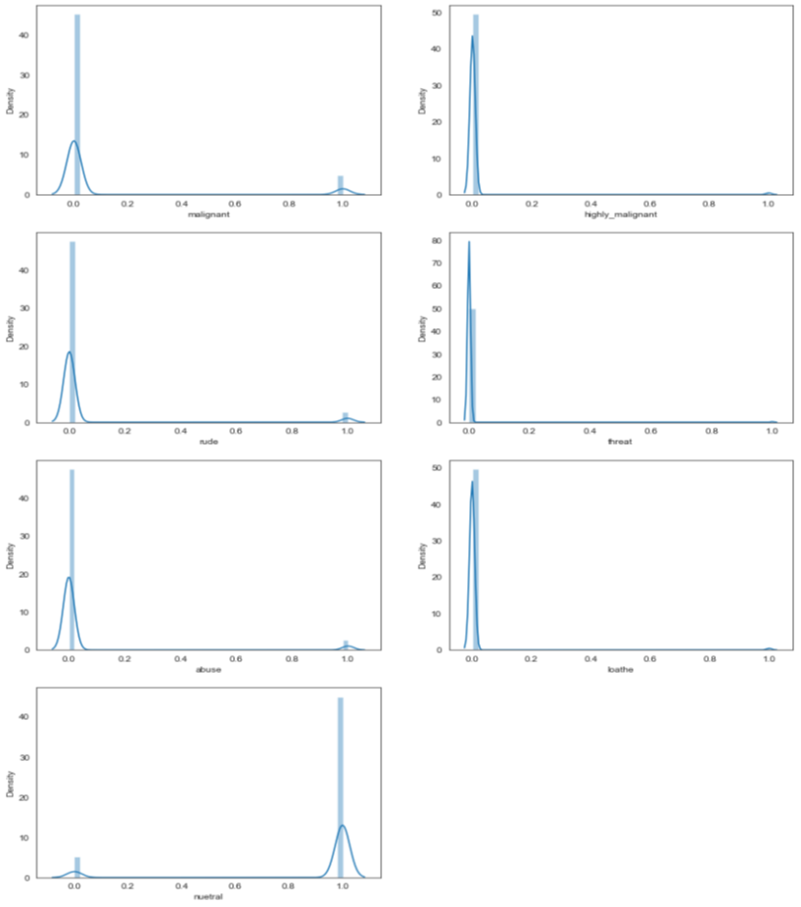
Plotting distribution plot for all features

Slide 31
CONCLUSION
After the completion of this project, we got an insight of how to preprocess the data, analysing the data and building a model.
First, we imported both training and testing data, which had nearly 150000+ records.
We did all the required pre-processing steps like checking null values, datatypes check, dropping unnecessary columns, etc.
We used the training data for doing Exploratory Data Analysis using various plots and recorded the observations.
While observing the results, we found that the dataset was in highly imbalanced side and we need to handle it, in order to avoid overfitting problem.
Using NLP, we pre-processed the comment text and did other steps.
As the problem was a multi-class classifier, we took a new feature known as label and combined the comment_labels output together using sum() and then stored in that feature. For a binary classification problem, we scaled the data accordingly.
After applying Tf-idf Vectoriser, we used an oversampling technique called RandomOverSampler for handling the imbalanced data. There, we took 75% of the high points data and sampled it to the low points data so that both weights could be balanced equally and we could get proper result.

Slide 32
Then, we split the data using train_test_split and then we started the model building process by running as many algorithms in a for loop, with difference metrics like cross_val_score, confusion matrix, auc_score, log loss, hamming loss, etc.
We found that RandomForestClassifier and XGBoostClassifier were performing well. The next step was to perform hyperparameter tuning technique to these models for finding out the best parameters and trying to improve our scores.
The major problem with this dataset occurred in this step. It took me nearly 2 hrs to run the code for finding out the best parameters itself as the dataset is large and more computational power was required. Even though we found the best algorithms, it took me 2 hrs to get the results.
Therefore, without hyperparameter tuning, we finalized RandomForest as the best performing algorithm by predicting the outputs, saving the model and storing the results in a csv file
Then, by using the model we got, another set of predictions were done by using the test data and the results were stored in a separate csv file.

Slide 33
Problems faced while working in this project:
More computational power was required as it took more than 2 hours
Imbalanced dataset and bad comment texts
Good parameters could not be obtained using hyperparameter tuning as time was consumed more
Areas of improvement:
Could be provided with a good dataset which does not take more time.
Less time complexity
Providing a proper balanced dataset with less errors.

